Slide 1
CRASH COURSE
JavaScript Crash Course
from zero JavaScript → able to build small interactive programs
DURATION
START POINT
OUTCOME
Roughly 4–6 hours
Zero JavaScript
Small interactive programs
… or spread it across a few days
no prior programming needed
written by you, from scratch
Here's a compact course designed to take you from zero JavaScript → able to build small interactive programs.
You can work through it in roughly 4–6 hours, or spread it across a few days.
JavaScript Crash Course

Slide 2
Contents
1
What JavaScript is
13
Loops
2
Where JavaScript fits
14
Destructuring
3
A short history
15
Spread syntax
4
JavaScript vs Java
16
The DOM
5
How to run JavaScript
17
Events
6
Variables
18
Async JavaScript
7
Operators
19
Modules
8
Strings
20
Classes
9
Conditions
21
Mini Project: Counter
10
Functions
22
Mini Project: Todo Logic
11
Arrays
23
The 80/20 of JavaScript
JavaScript Crash Course
2
12
Objects

Slide 3
01
What JavaScript is
JavaScript is the programming language that makes websites interactive.
HTML
CSS
JavaScript
provides structure
provides appearance
provides behavior
For example:
console.log("Hello, world!");
console.log() prints something to the browser's developer console.
JavaScript
JavaScript Crash Course
3

Slide 4
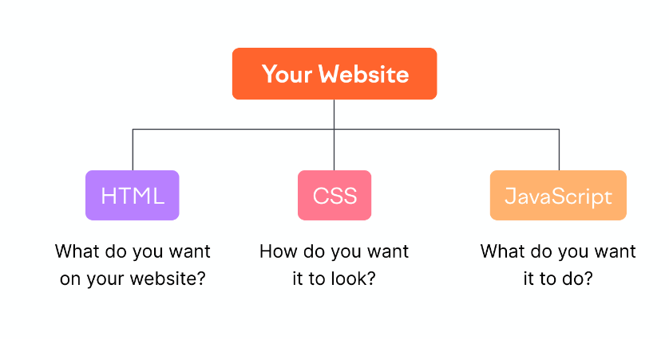
02
Where JavaScript fits in the front-end
JavaScript (JS) is a computer programming language used to make websites and applications dynamic and interactive.
Front-end languages
HTML — what do you want on your website?
CSS — how do you want it to look?
JavaScript — what do you want it to do?
JavaScript Crash Course
4

Slide 5
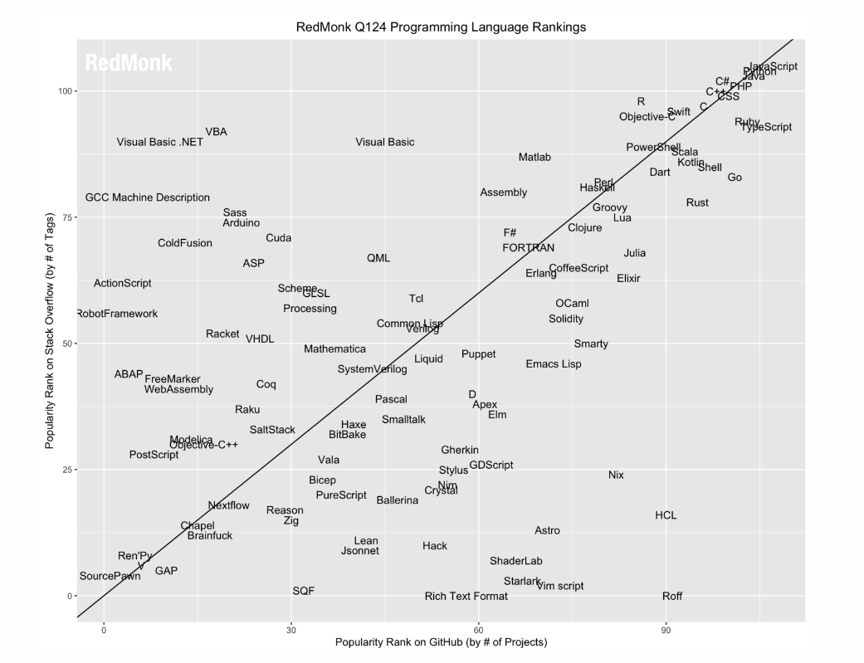
02
Ranking of Programming Languages (2024)
RedMonk ranks languages by GitHub projects and Stack Overflow activity.
Top tier (both axes)
JavaScript · Python · Java · C# · PHP · C++ · CSS · C
The y-axis is popularity rank on Stack Overflow (by number of tags); the x-axis is popularity rank on GitHub (by number of projects). JavaScript sits in the top group on both.
Source: https://redmonk.com/sogrady/2024/03/08/language-rankings-1-24/
JavaScript Crash Course
5

Slide 6
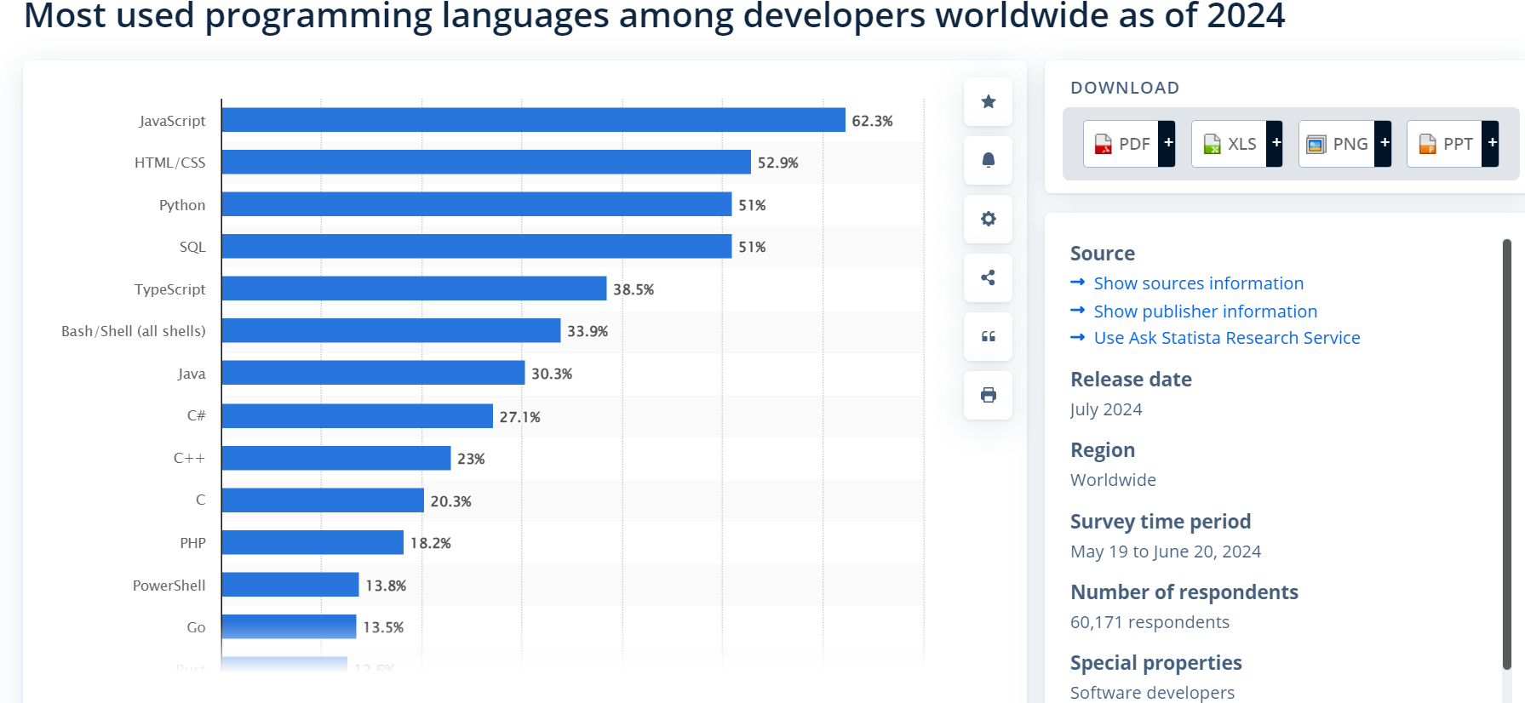
02
Most used programming languages (2024)
Most used programming languages among developers worldwide, 2024.
JavaScript leads again
62.3% of surveyed developers use JavaScript — ahead of HTML/CSS (52.9%), Python (51%) and SQL (51%).
60,171 developers surveyed · 2024
Source: https://www.statista.com/statistics/793628/worldwide-developer-survey-most-used-languages/
JavaScript Crash Course
6

Slide 7
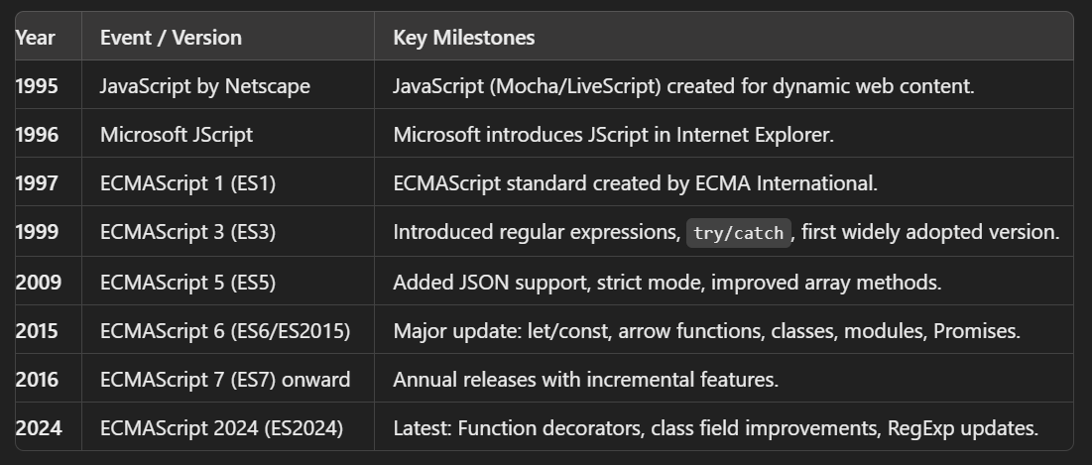
03
A short history of JavaScript
From a browser scripting language to a yearly-released standard.
1995 created at Netscape
1997 ECMAScript standard
2015 ES6: let/const, arrow functions, classes, modules, Promises
2016 → annual ES releases
JavaScript Crash Course
7

Slide 8
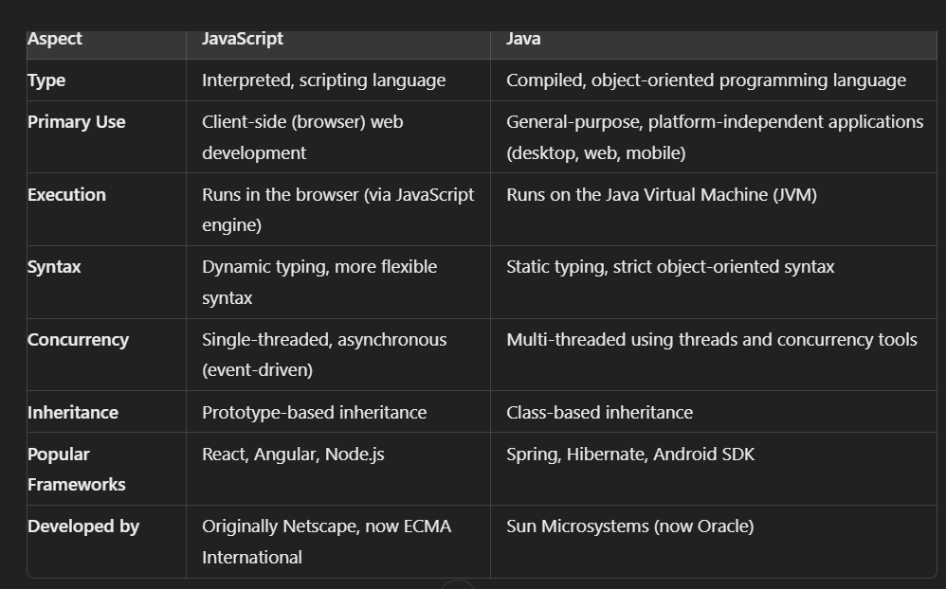
04
JavaScript vs Java
Two languages with similar names and almost nothing else in common.
Why the confusion?
JavaScript was named for marketing, not for Java. The two differ in typing, execution model and inheritance:
JavaScript — interpreted, dynamic typing, runs in the browser, prototype-based.
Java — compiled to bytecode, static typing, runs on the JVM, class-based.
JavaScript Crash Course
8

Slide 9
05
How to run JavaScript
Three ways to execute JavaScript today.
1. In the Browser
2. In HTML Files
3. Using Node.js
▪ Open browser (e.g., Chrome)
▪ Embed JavaScript in <script> tags within an HTML file
▪ Install Node.js
▪ Open Developer Tools (Right-click > Inspect > Console tab)
▪ Open the HTML file in a browser
▪ Create a .js file (e.g., app.js)
▪ Type JavaScript code in the Console
▪ Example: <script>console.log("Hello, JavaScript!");</script>
▪ Run the file in terminal: node app.js
JavaScript Crash Course
9

Slide 10
05
Your first HTML page with JavaScript
Embed JavaScript in <script> tags within an HTML file.
<!DOCTYPE html>
<html lang="en">
<head>
<meta charset="UTF-8">
<meta name="viewport" content="width=device-width, initial-scale=1.0">
<title>Document</title>
</head>
<body>
<script>
console.log("Hello World");
alert("Hello World");
</script>
</body>
</html>
What happens
console.log() writes to the developer console.
alert() shows a pop-up dialog in the browser.
HTML
JavaScript Crash Course
10

Slide 11
06
Variables
Variables store information.
▪ Use const by default. Use let when the value needs to change.
▪ You'll occasionally encounter var in older JavaScript, but you generally shouldn't use it in new code.
let name = "Alex";
let age = 25;
const country = "Canada";
console.log(name);
console.log(age);
let score = 10;
score = 20; // allowed
const pi = 3.14159;
pi = 4; // error
var age = 25; // Use let instead of var
let & const
the important distinction
JavaScript Crash Course
11

Slide 12
06
Variables — basic data types
Basic data types
const name = "Alex"; // string
const age = 25; // number
const isStudent = true; // boolean
const nothing = null; // null
let unknown; // undefined
const list = [1, 2, 3]; // array
const user = { name: "John", age: 25 }; // object
You can inspect a value's type — use the typeof() method:
data types
console.log(typeof "hello"); // "string"
console.log(typeof 42); // "number"
console.log(typeof true); // "boolean"
typeof
JavaScript Crash Course
12

Slide 13
06
Variables — rules for naming
Rules for naming JavaScript variables.
▪ Must start with a letter, _, or $ (cannot start with a number).
Good vs bad:
▪ Can contain letters, digits, _, and $ (no spaces, no special characters).
let totalAmount = 100; // ✅ good
let 2price = 100; // ❌ bad
let return = 5; // ❌ bad
naming
▪ Case-sensitive (user ≠ User).
▪ Cannot use reserved keywords (e.g., let, class, return).
▪ Use camelCase by convention for readability (totalPrice, userName).
▪ Make names descriptive and meaningful, not cryptic.
Reading input from the user:
<script>
name = prompt("What is your name?");
alert("Hello " + name);
console.log("Hello " + name);
</script>
prompt / alert
JavaScript Crash Course
13

Slide 14
07
Operators — arithmetic & comparison
JavaScript supports normal arithmetic:
const x = 10;
const y = 3;
console.log(x + y); // 13
console.log(x - y); // 7
console.log(x * y); // 30
console.log(x / y); // 3.333...
console.log(x % y); // 1
console.log(x ** y); // 1000
Comparisons produce booleans:
arithmetic
10 > 5 // true
10 < 5 // false
10 === 10 // true
10 !== 5 // true
comparisons
JavaScript Crash Course
14

Slide 15
07
Operators — strict equality & logic
Prefer strict equality:
Logical operators are AND (&&), OR (||), NOT (!):
5 === "5" // false
5 == "5" // true
let isAdult = true;
let hasID = false;
console.log(isAdult && hasID); // false
console.log(isAdult || hasID); // true
console.log(!isAdult); // false
=== vs ==
logical
=== compares both value and type, which makes behavior more predictable.
true && false // AND
true || false // OR
!true // NOT
with plain values
JavaScript Crash Course
15

Slide 16
07
Operators — the Math object
The Math object provides useful methods for mathematical operations.
console.log(Math.sqrt(16)); // 4
console.log(Math.pow(2, 3)); // 8
console.log(Math.abs(-10)); // 10
console.log(Math.floor(4.7)); // 4
console.log(Math.ceil(4.2)); // 5
console.log(Math.random()); // e.g. 0.3456
console.log(Math.PI); // 3.141592653589793
// Random number between 1 and 10
let randomNum = Math.floor(Math.random() * 10) + 1;
console.log(randomNum);
common methods
random range
Math.sqrt(16) → 4
Math.floor(x) rounds down, Math.ceil(x) rounds up
Math.random() returns a number between 0 and 1
JavaScript Crash Course
16

Slide 17
08
Strings
Strings represent text.
const firstName = "John";
const lastName = "Smith";
const fullName = firstName + " " + lastName;
Modern JavaScript commonly uses template literals:
concatenation
const name = "John";
const age = 30;
console.log(`My name is ${name} and I am ${age} years old.`);
template literals
JavaScript Crash Course
17

Slide 18
08
Strings — declaring them
Strings can be created using single quotes ('), double quotes ("), or template literals (`).
let singleQuote = 'Hello';
let doubleQuote = "World";
let templateLiteral = `Hello, ${doubleQuote}!`;
console.log(templateLiteral); // Hello, World!
Only backticks interpolate
${…} only works inside template literals — single and double quotes give you a plain string.
three ways
Use + or template literals to combine strings:
let fullName = firstName + " " + lastName;
let welcome = `Hello, ${firstName} ${lastName}!`;
concatenation
JavaScript Crash Course
18

Slide 19
08
Strings — useful methods
Useful string methods include:
const text = "JavaScript";
text.length
text.toUpperCase()
text.toLowerCase()
text.includes("Script")
text.indexOf("Script")
text.slice(0, 4)
Called on the string with dot notation:
text.length → 10
text.toUpperCase() → "JAVASCRIPT"
text.toLowerCase() → "javascript"
text.includes("Script") → true
text.indexOf("Script") → 4
text.slice(0, 4) → "Java"
string methods
JavaScript Crash Course
19

Slide 20
09
Conditions
Conditions allow programs to make decisions.
const age = 20;
if (age >= 18) {
console.log("Adult");
} else {
console.log("Minor");
}
You can have multiple conditions:
if / else
const score = 85;
if (score >= 90) {
console.log("A");
} else if (score >= 80) {
console.log("B");
} else if (score >= 70) {
console.log("C");
} else {
console.log("Needs improvement");
}
else if
JavaScript Crash Course
20

Slide 21
09
Conditions — the ternary operator
A compact conditional is the ternary operator:
const age = 20;
const status = age >= 18 ? "adult" : "minor";
let isLoggedIn = true;
let message = isLoggedIn ? "Welcome back!" : "Please log in.";
console.log(message); // Welcome back!
ternary operator
in practice
Think:
condition ? valueIfTrue : valueIfFalse
JavaScript Crash Course
21

Slide 22
10
Functions
Functions package reusable behavior.
function greet(name) {
return `Hello, ${name}!`;
}
console.log(greet("Sam"));
Modern JavaScript also uses arrow functions heavily:
function declaration
const greet = (name) => {
return `Hello, ${name}!`;
};
arrow function
JavaScript Crash Course
22

Slide 23
10
Functions — short arrows & mental model
A short version:
const double = number => number * 2;
console.log(double(5)); // 10
A useful mental model is:
short arrow
input
function
output
For example:
const calculateTax = price => price * 0.15;
calculateTax(100); // 15
calculateTax
JavaScript Crash Course
23

Slide 24
10
Functions — expressions & when to use which
Functions take inputs (parameters) and return a result.
const add = function(x, y) {
return x + y;
};
console.log(add(5, 3)); // 8
const multiply = (x, y) => x * y;
console.log(multiply(4, 3)); // 12
function expression
arrow (ES6)
When to use which:
Declarations — best for global, reusable functions or helper methods in vanilla JS or outside React components.
Expressions — useful for defining localized, non-hoisted functions in both vanilla JS and React, especially when scoping control is required.
Arrow functions — the preferred choice in React for functional components, event handlers, and concise, lexically-scoped callback functions.
JavaScript Crash Course
24

Slide 25
11
Arrays
Arrays store collections of values.
const fruits = ["apple", "banana", "orange"];
console.log(fruits[0]); // apple
console.log(fruits[1]); // banana
▪ Array positions start at 0, not 1.
basics
▪ Useful operations:
const fruits = ["apple", "banana"];
fruits.push("orange");
fruits.pop();
console.log(fruits.length);
push / pop
and the other end of the array — add to start, remove first:
let animals = ["Cat", "Dog", "Elephant"];
animals.unshift("Tiger"); // Add to start
animals.shift(); // Remove first element
unshift / shift
JavaScript Crash Course
25

Slide 26
11
Arrays — map, filter, find
Three extremely important array methods are map, filter, and find.
const numbers = [1, 2, 3, 4];
const doubled = numbers.map(number => number * 2);
console.log(doubled);
// [2, 4, 6, 8]
const numbers = [1, 2, 3, 4, 5];
const bigNumbers = numbers.filter(number => number > 3);
console.log(bigNumbers);
// [4, 5]
map() — Transform every item
filter() — Keep certain items
const users = [
{ name: "Alice", age: 22 },
{ name: "Bob", age: 35 }
];
const user = users.find(user => user.name === "Bob");
console.log(user);
Mastering array methods will make modern JavaScript considerably easier.
find() — Find one item
JavaScript Crash Course
26

Slide 27
11
Arrays — looping through them
Looping through arrays with an index.
let colors = ["Red", "Green", "Blue"];
for (let i = 0; i < colors.length; i++) {
console.log(colors[i]);
}
i counts from 0 while i < colors.length, and colors[i] reads the item at that position.
indexed for loop
JavaScript Crash Course
27

Slide 28
12
Objects
Objects group related information.
const person = {
name: "Alice",
age: 25,
city: "Montreal"
};
console.log(person.name);
console.log(person.age);
Object properties store key-value pairs:
object literal
console.log(person["city"]); // Montreal
bracket access
Properties can change:
person.age = 26;
console.log(person.age); // 26
mutation
JavaScript Crash Course
28

Slide 29
12
Objects — methods & real-world data
Objects can contain functions called methods:
const person = {
name: "Alice",
greet() {
console.log(`Hello, I'm ${this.name}`);
}
};
person.greet();
Most real-world JavaScript data is essentially combinations of objects and arrays:
methods
const users = [
{
id: 1,
name: "Alice",
skills: ["JavaScript", "HTML"]
},
{
id: 2,
name: "Bob",
skills: ["Python", "SQL"]
}
];
objects + arrays
JavaScript Crash Course
29

Slide 30
12
Objects — looping through them
Looping through objects with for...in.
let car = { brand: "Toyota", model: "Corolla", year: 2020 };
for (let key in car) {
console.log(key + ": " + car[key]);
}
for...in gives you each key, and car[key] reads the matching value.
Use it when you want to walk every property of one object; use for...of when you want the values of an array.
for...in
// brand: Toyota
// model: Corolla
// year: 2020
output
JavaScript Crash Course
30

Slide 31
13
Loops
Loops repeat code.
for (let i = 0; i < 5; i++) {
console.log(i);
}
0
1
2
3
4
for
output
Usually cleaner for arrays — for...of:
Arrays also commonly use forEach:
const fruits = ["apple", "banana", "orange"];
for (const fruit of fruits) {
console.log(fruit);
}
fruits.forEach(fruit => {
console.log(fruit);
});
for...of
forEach
JavaScript Crash Course
31

Slide 32
13
Loops — while
Loops are used to repeat blocks of code.
let count = 0;
while (count < 3) {
console.log("Count:", count);
count++;
}
Use for when you know how many times to repeat; use while when the loop should run until a condition stops being true.
count++ is what eventually makes the condition false — without it the loop never ends.
while
// Count: 0
// Count: 1
// Count: 2
output
JavaScript Crash Course
32

Slide 33
14
Destructuring
Modern JavaScript uses destructuring frequently.
Instead of:
you can write:
const person = {
name: "Alice",
age: 25
};
const name = person.name;
const age = person.age;
const { name, age } = person;
the long way
object destructuring
Arrays work similarly:
const colors = ["red", "green", "blue"];
const [first, second] = colors;
array destructuring
JavaScript Crash Course
33

Slide 34
15
Spread syntax
The ... operator can copy or combine values.
Arrays:
Objects:
const a = [1, 2];
const b = [3, 4];
const numbers = [...a, ...b];
console.log(numbers);
// [1, 2, 3, 4]
const user = {
name: "Alice",
age: 25
};
const updatedUser = {
...user,
age: 26
};
arrays
objects
▪ This pattern appears constantly in modern frontend development.
JavaScript Crash Course
34

Slide 35
16
The DOM
Now JavaScript becomes useful for webpages.
Suppose your HTML contains:
JavaScript can access those elements:
<h1 id="title">Hello</h1>
<button id="button">Click me</button>
const title = document.querySelector("#title");
const button = document.querySelector("#button");
HTML
querySelector
And modify them:
Or change CSS:
title.textContent = "JavaScript is working!";
title.style.color = "red";
modify
style
JavaScript Crash Course
35

Slide 36
17
Events
Events let JavaScript react to users.
const button = document.querySelector("#button");
button.addEventListener("click", () => {
console.log("Button clicked!");
});
Combine that with DOM manipulation:
listening
const title = document.querySelector("#title");
const button = document.querySelector("#button");
button.addEventListener("click", () => {
title.textContent = "You clicked the button!";
});
DOM + events
This concept powers a huge amount of frontend development:
User action
Event
JavaScript function
Page changes
JavaScript Crash Course
36

Slide 37
18
Async JavaScript
JavaScript often needs to wait for things like servers, databases, timers, or files.
A simple example:
Modern asynchronous JavaScript revolves around Promises and async/await.
setTimeout(() => {
console.log("2 seconds later");
}, 2000);
setTimeout
async function getUsers() {
const response = await fetch("https://example.com/api/users");
const users = await response.json();
console.log(users);
}
async / await
The key idea:
await = wait for this asynchronous operation to finish
JavaScript Crash Course
37

Slide 38
18
Async JavaScript — error handling
Use error handling around operations that can fail:
async function getUsers() {
try {
const response = await fetch("https://example.com/api/users");
if (!response.ok) {
throw new Error("Request failed");
}
const users = await response.json();
console.log(users);
} catch (error) {
console.error(error);
}
}
try → attempt the operation
catch → handle the failure
throw → signal a problem
try / catch
JavaScript Crash Course
38

Slide 39
19
Modules
As programs grow, code gets separated into files.
math.js — exports:
app.js — imports:
export function add(a, b) {
return a + b;
}
import { add } from "./math.js";
console.log(add(2, 3));
math.js
app.js
▪ This allows applications to be divided into reusable components.
JavaScript Crash Course
39

Slide 40
20
Classes
You'll encounter classes in JavaScript codebases:
class Person {
constructor(name, age) {
this.name = name;
this.age = age;
}
greet() {
return `Hello, I'm ${this.name}`;
}
}
const alice = new Person("Alice", 25);
console.log(alice.greet());
You don't need to master classes immediately. Functions, objects, and arrays are more important for a beginner.
class Person
JavaScript Crash Course
40

Slide 41
21
Mini Project: Counter
Here's your first complete interactive program.
HTML:
<h1 id="count">0</h1>
<button id="minus">-</button>
<button id="plus">+</button>
<script src="app.js"></script>
A display (#count), two buttons (#minus / #plus), and the script that makes it work.
HTML
JavaScript Crash Course
41

Slide 42
21
Mini Project: Counter — the JavaScript
JavaScript:
let count = 0;
const display = document.querySelector("#count");
const plusButton = document.querySelector("#plus");
const minusButton = document.querySelector("#minus");
function updateDisplay() {
display.textContent = count;
}
plusButton.addEventListener("click", () => {
count++;
updateDisplay();
});
minusButton.addEventListener("click", () => {
count--;
updateDisplay();
});
State lives in count — every click changes state, then updateDisplay() re-renders the page.
app.js
JavaScript Crash Course
42

Slide 43
21
Mini Project: Counter — what it teaches
Despite being tiny, this project contains several core concepts:
variable
▼
DOM elements
▼
event listeners
▼
functions
▼
state changes
▼
UI updates
That same basic pattern scales surprisingly far.
JavaScript Crash Course
43

Slide 44
22
Mini Project: Todo Logic
Try this without looking up the solution first.
Create an array:
Write these functions:
const todos = [];
addTodo("Learn JavaScript");
removeTodo(0);
showTodos();
the data
the API
addTodo(…) adds a todo · removeTodo(…) removes one · showTodos() lists them all
JavaScript Crash Course
44

Slide 45
22
Mini Project: Todo Logic — a solution
A simple implementation could look like:
const todos = [];
function addTodo(todo) {
todos.push(todo);
}
function removeTodo(index) {
todos.splice(index, 1);
}
function showTodos() {
todos.forEach((todo, index) => {
console.log(`${index + 1}. ${todo}`);
});
}
addTodo("Learn variables");
addTodo("Learn functions");
addTodo("Build a project");
showTodos();
Your next challenge is to connect this logic to HTML buttons and inputs.
app.js
JavaScript Crash Course
45

Slide 46
23
The 80/20 of JavaScript
Don't try to memorize the entire language. Focus first on:
Variables
▼
Conditions
▼
Functions
▼
Arrays
▼
Objects
▼
Array methods
▼
DOM
▼
Events
▼
async/await
If you can comfortably use those concepts, you have enough JavaScript knowledge to start building real projects.
A good progression is Counter → Calculator → Todo App → Quiz App → Weather/API App → then a framework such as React.
The most important part is writing code yourself rather than only reading tutorials.
JavaScript Crash Course
46

